Slide 1


Tan Shan Mei
18 Apr 2024

Slide 2

Outline
Executive Summary
Introduction
Methodology
Results
Conclusion
Appendix

Slide 3
Executive Summary
Summary of methodologies
Data Collection
Data Wrangling
Exploratory Data Analysis with Data Visualization
Exploratory Data Analysis with SQL
Building interactive map with Folium
Building Dashboard with Plotly Dash
Predictive Modelling (Classification)
Summary of all results
Exploratory Data Analysis results
Interactive analytics screenshots
Predictive modelling results

Slide 4
Introduction
Project background and context
SpaceX has revolutionized the space industry with significant reductions in launch costs, primarily through the innovation of reusable rocket technology.
Our project revolves around analyzing data from SpaceX's past launches to gain insights into their cost-saving strategies and predict future launch successes.
Problems you want to find answers
Identify patterns in launch outcomes based on variables like payload mass, destination orbit, and landing site conditions.
Predictive Modeling: Develop a predictive model to assess whether the first stage of a Falcon 9 rocket will land successfully.
Cost estimation bidding: Determine the cost of a launch based on success of rocket landings.

Slide 5

Section 1

Slide 6
Methodology
Executive Summary
Data collection methodology:
Utilized the SpaceX REST API to fetch historical launch data in JSON format.
Web Scraped relevant Wikipedia pages for Falcon 9 launch records using BeautifulSoup.
Perform data wrangling
Cleaned and structured raw JSON and HTML data into usable Pandas DataFrames.
Filtered data to focus on Falcon 9 and handled missing or null values in the dataset and One Hot Encoding
Perform exploratory data analysis (EDA) using visualization and SQL
Perform interactive visual analytics using Folium and Plotly Dash
Perform predictive analysis using classification models
Applied classification algorithms (e.g., Logistic Regression, Decision Trees) to predict rocket landing successes.
Tuned models' hyperparameters to improve predictive performance using evaluation metrics like accuracy, precision, recall, and F1-score.

Slide 7
Data Collection
Data collection process involve combining data from both SpaceX’s API and web scraping SpaceX’s Wikipedia tables in order to get a detailed analysis of the rocket launches.
Features from SpaceX Rest API | FlightNumber, Date, BoosterVersion, PayloadMass, Orbit, LaunchSite, Outcome, Flights, GridFins, Reused, Legs, LandingPad, Block, ReusedCount, Serial, Longitude, Latitude
Features from Wikipedia Web Scraping | Flight No., Launch site, Payload, PayloadMass, Orbit, Customer, Launch outcome, Version Booster, Booster landing, Date, Time

Slide 8
Data Collection – SpaceX API
Request rocket launch data from SpaceX API
Decoding response content using .json() and convert to dataframe using .json_normalize()
Requesting needed information about the alunces from SpaceX API through applying custom functions
Constructing data obtained into a dictionary
Filter data to include only Falcon 9 launches
Replace missing values of PayloadMass column with calculated .mean()
Exporting data to .csv file
GitHub URL: Data Collection - SpaceX API

Slide 9
Data Collection - Scraping
Requesting Falcon 9 launce data from Wikipedia
Creating BeautifulSoup object from the HTML response
Extracting all columns names from the HTML table header
Collecting data by parsing HTML tables
Constructing data obtained into a dictionary
Convert dictionary into a dataframe
Exporting the data into .csv file
GitHub URL: Data Collection - Scraping

Slide 10
Data Wrangling
In the data set, there are several different cases where the booster did not land successfully. Sometimes a landing was attempted but failed due to an accident; for example, True Ocean means the mission outcome was successfully landed to a specific region of the ocean while False Ocean means the mission outcome was unsuccessfully landed to a specific region of the ocean. True RTLS means the mission outcome was successfully landed to a ground pad False RTLS means the mission outcome was unsuccessfully landed to a ground pad. True ASDS means the mission outcome was successfully landed on a drone ship False ASDS means the mission outcome was unsuccessfully landed on a drone ship.
We will mainly convert those outcomes into Training Labels with `1` means the booster successfully landed `0` means it was unsuccessful.
Perform EDA and determine Training Labels
Calculate the number of launches on each site
Calculate the number and occurrence of each orbit
Calculate the number and occurrence of mission outcome per orbit type
Create landing outcome label from Outcome column
Exporting the data to CSV file
GitHub URL: Data Wrangling

Slide 11
EDA with Data Visualization
Charts were plotted: Flight Number vs. Payload Mass, Flight Number vs. Launch Site, Payload Mass vs. Launch Site, Orbit Type vs. Success Rate, Flight Number vs. Orbit Type, Payload Mass vs Orbit Type and Success Rate Yearly Trend
Scatter plots show the relationship between variables. If a relationship exists, they could be used in machine learning model.
Bar charts show comparisons among discrete categories. The goal is to show the relationship between the specific categories being compared and a measured value.
Line charts show trends in data over time (time series).
Prepare Data Feature Engineering
GitHub URL: EDA with Data Visualization

Slide 12
EDA with SQL
Exploratory Data Analysis using SQL queries are executed to understand more about the SpaceX Dataset through connection to the database
SQL queries:
Displaying the names of the unique launch sites in the space mission
Displaying 5 records where launch sites begin with the string ‘CCA’
Displaying the total payload mass carried by boosters launched by NASA (CRS) • Displaying average payload mass carried by booster version F9 v1.1
Listing the date when the first successful landing outcome in ground pad was achieved
Listing the names of the boosters which have success in drone ship and have payload mass greater than 4000 but less than 6000
Listing the total number of successful and failure mission outcomes
Listing the names of the booster versions which have carried the maximum payload mass
Listing the failed landing outcomes in drone ship, their booster versions and launch site names for the months in year 2015
Ranking the count of landing outcomes (such as Failure (drone ship) or Success (ground pad)) between the date 2010-06-04 and 2017-03-20 in descending order
GitHub URL: EDA with SQL

Slide 13
Build an Interactive Map with Folium
Markers of all Launch Sites:
Added Marker with Circle, Popup Label and Text Label of NASA Johnson Space Center using its latitude and longitude coordinates as a start location.
Added Markers with Circle, Popup Label and Text Label of all Launch Sites using their latitude and longitude coordinates to show their geographical locations and proximity to Equator and coasts.
Coloured Markers of the launch outcomes for each Launch Site:
Added coloured Markers of success (Green) and failed (Red) launches using Marker Cluster to identify which launch sites have relatively high success rates.
Distances between a Launch Site to its proximities:
Added coloured Lines to show distances between the Launch Site KSC LC-39A (as an example) and its proximities like Railway, Highway, Coastline and Closest City
GitHub URL: Build an Interactive Map with Folium

Slide 14
Build a Dashboard with Plotly Dash
Launch Sites Dropdown List:
Added a dropdown list to enable Launch Site selection. Pie Chart showing
Success Launches (All Sites/Certain Site):
Added a pie chart to show the total successful launches count for all sites and the Success vs. Failed counts for the site, if a specific Launch Site was selected.
Slider of Payload Mass Range:
Added a slider to select Payload range. Scatter Chart of Payload Mass vs. Success.
Rate for the different Booster Versions:
Added a scatter chart to show the correlation between Payload and Launch Success.
GitHub URL: Build a Dashboard with Plotly Dash

Slide 15
Predictive Analysis (Classification)
Creation of a machine learning pipeline to predict if the first stage will land given the data collected and feature engineered.
Creating a NumPy array from the column "Class" in data
Splitting the data into train and test set with train_test_split function
Creating a GridSearchCV object with cv=10 to find the best parameters
Standardizing with StandardScalar, then fitting and transforming it.
Applying GridSearchCV on LogRegm SVM, Decision Tree, and KNN models.
Calculating the accuracy on test data using method .score() for all models
Examining the confusion matrix for all the models
GitHub URL: Predictive Analysis (Classification)

Slide 16
Results
Exploratory data analysis results
Interactive analytics demo in screenshots
Predictive analysis results

Slide 17

Section 2

Slide 18
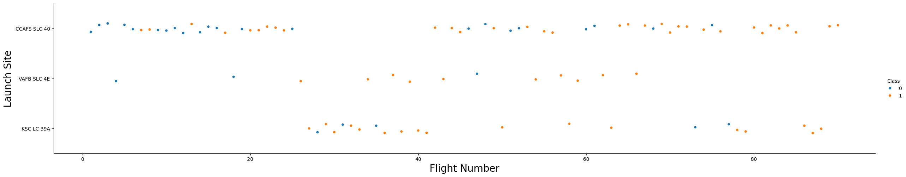
Flight Number vs. Launch Site
Explanations:
VAFB SLC 4E and KSC LC 39A have higher success rates
There were higher proportions of launces from CCAFS SLC 40

Slide 19
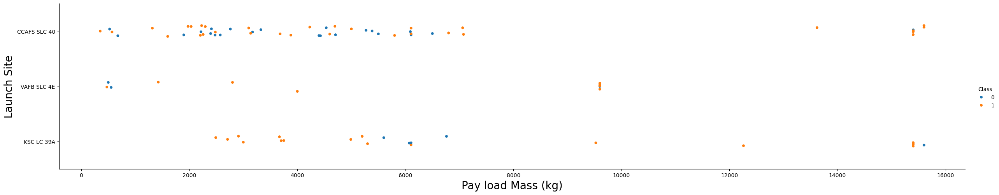
Payload vs. Launch Site
Explanations:
Majority of the launches are of PayloadMass < 8000kg.
For launches with PayloadMass > 9000, there is a higher success rate.

Slide 20
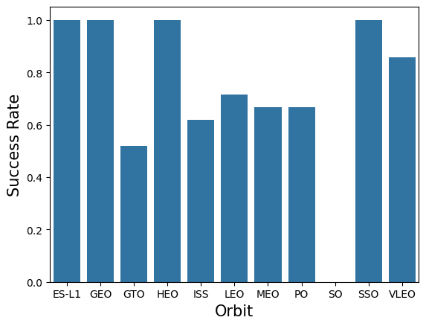
Success Rate vs. Orbit Type
Explanations:
Orbits with 100% Success Rate are ES-L1, GEO, HEO, and SSO
Oribits with 0% Success Rate is SO.
Orbits with Success Rate between 50% - 85% are GTO, ISS, LEO, MEO, and PO.

Slide 21
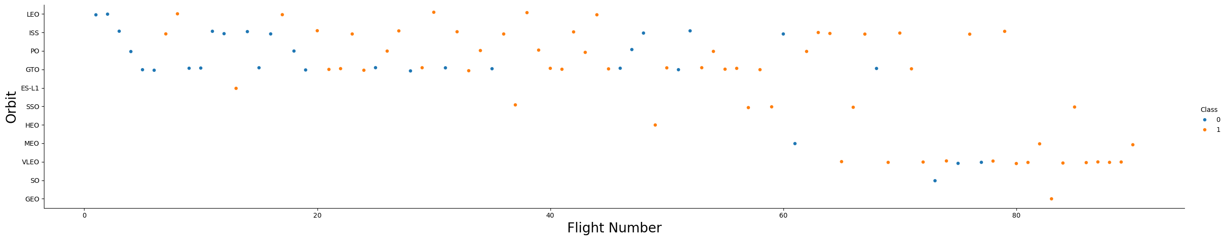
Flight Number vs. Orbit Type
Explanations:
No visible relationship can be observed between Flight Number and Orbit Type

Slide 22
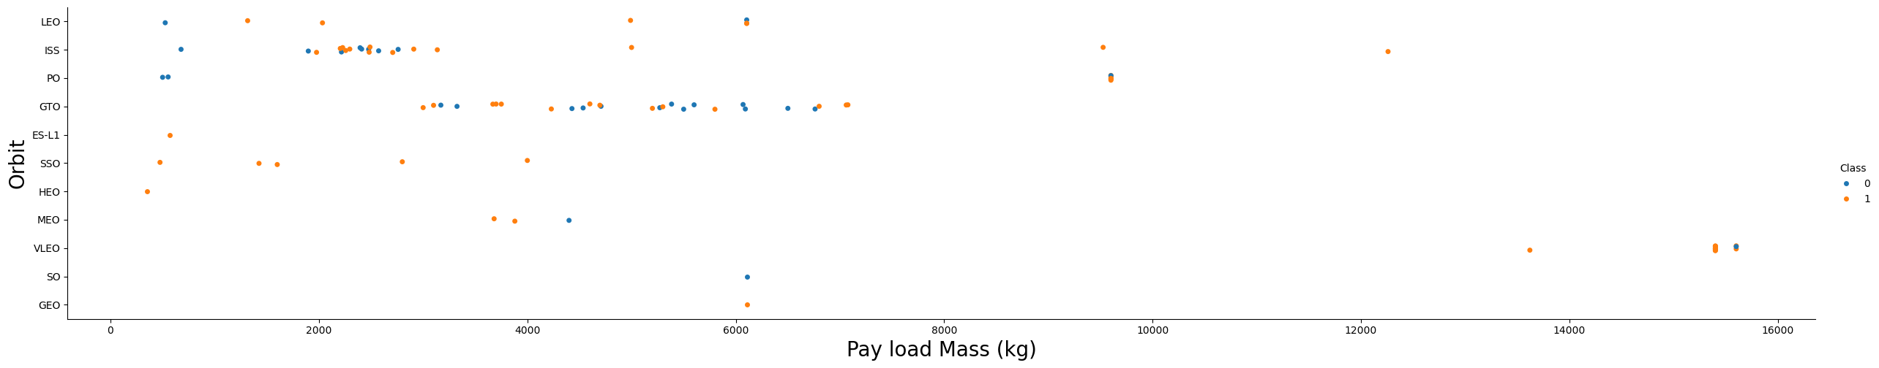
Payload vs. Orbit Type
Explanations:
Heavy payloads have negative influence on GTO orbits and positive influence on GTO and ISS orbits.

Slide 23
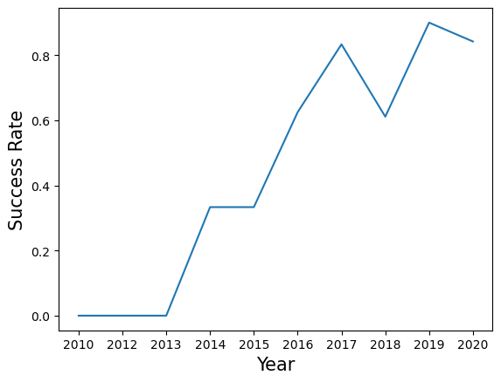
Launch Success Yearly Trend
Explanations:
The success rate is increasing on an increasing rate from 2013 to 2020.
The success rate from 2010 – 2013 is 0%

Slide 24
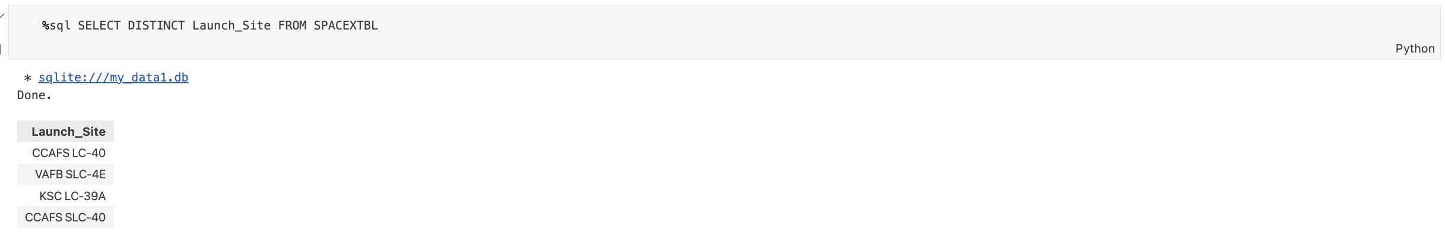
All Launch Site Names
Explanations:
Displaying the unique launch site names from SpaceX mission dataset.

Slide 25
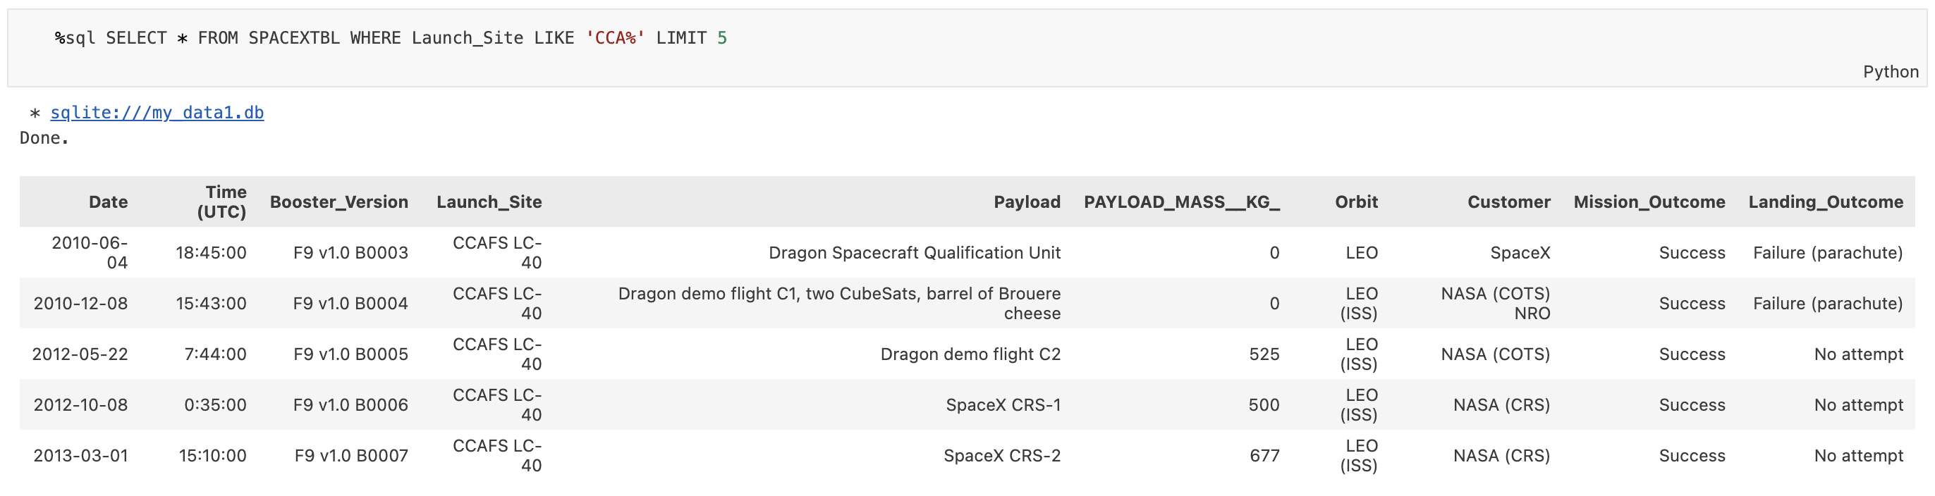
Launch Site Names Begin with 'CCA'
Explanations:
Displaying 5 records where Launch_Site begins with the string “CCA”.

Slide 26
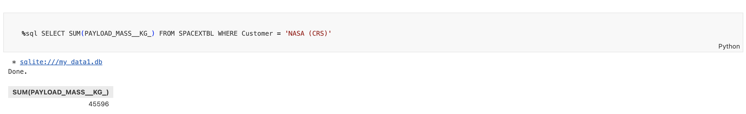
Total Payload Mass
Explanations:
Displaying the total payload mass carried by boosters launched by NASA (CRS) which equals to 45596.

Slide 27
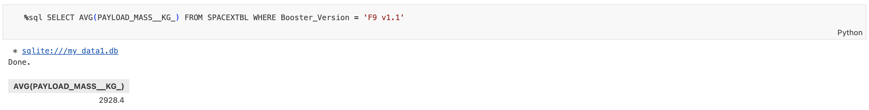
Average Payload Mass by F9 v1.1
Explanations:
Displaying average payload mass carried by booster version F9 v1.1 which is equal to 2928.4.

Slide 28
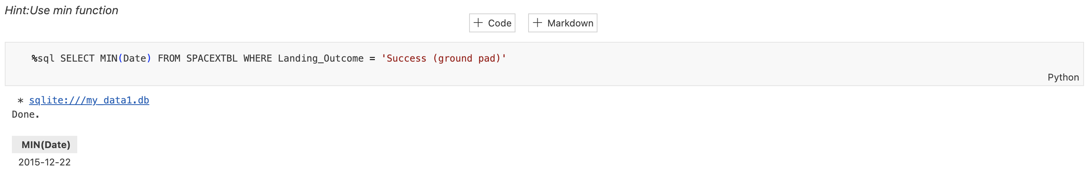
First Successful Ground Landing Date
Explanations:
The date when the 1st successful landing outcome (ground pad) was achieved which is 22 December 2015.

Slide 29
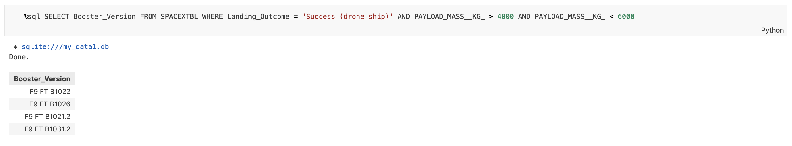
Successful Drone Ship Landing with Payload between 4000 and 6000
Explanations:
Displaying the booster version names which have success in drone ship and have a 4000 < payload mass < 6000.

Slide 30
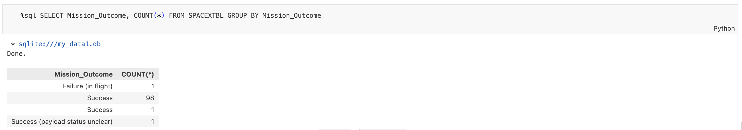
Total Number of Successful and Failure Mission Outcomes
Explanations:
Listing the total number of successful and failure SpaceX mission outcomes from the dataset.

Slide 31
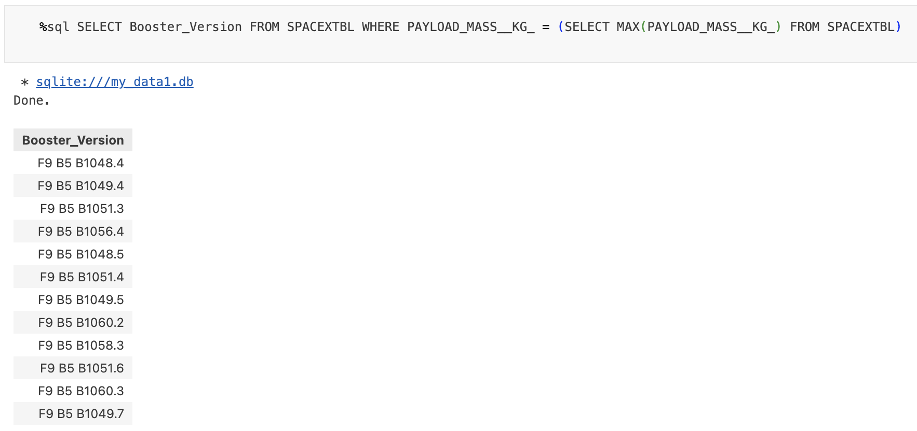
Boosters Carried Maximum Payload
Explanations:
Displaying the names of the booster version names which have carried out the maximum payload mass.

Slide 32
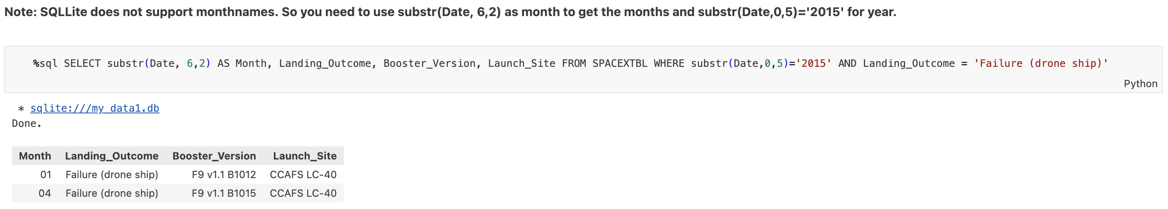
2015 Launch Records
Explanations:
Listing the failed landing outcomes in drone ship, their booster version, and launch site names for the months in year 2015.

Slide 33
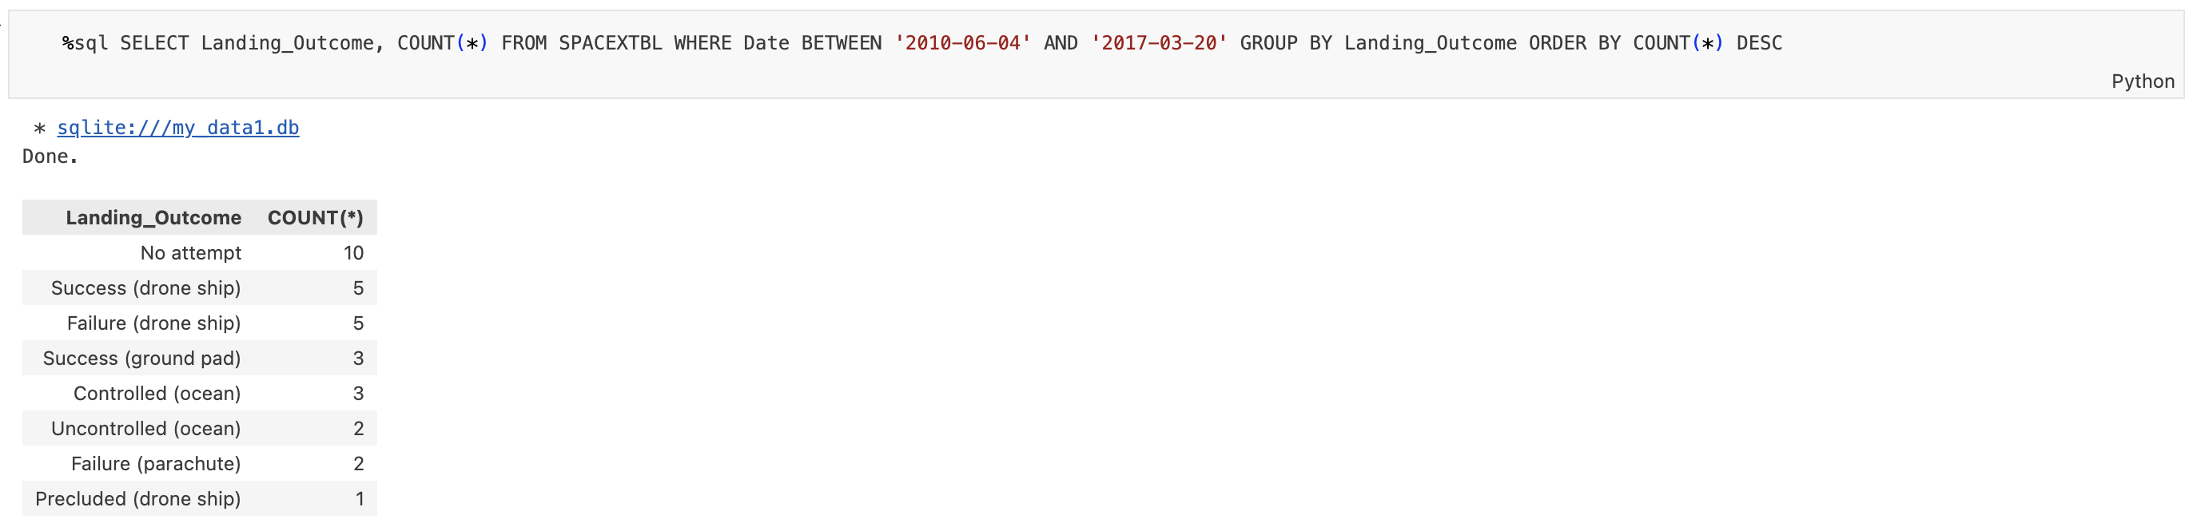
Rank Landing Outcomes Between 2010-06-04 and 2017-03-20
Explanations:
Ranking the count of landing outcomes from the period between 2010-06-04 and 2017-03-20 in descending order.

Slide 34

Section 3

Slide 35

<Folium Map Screenshot 1>
All launch sites’ location markers on a global map
All launch sites are in close proximity to the coast.

Slide 36
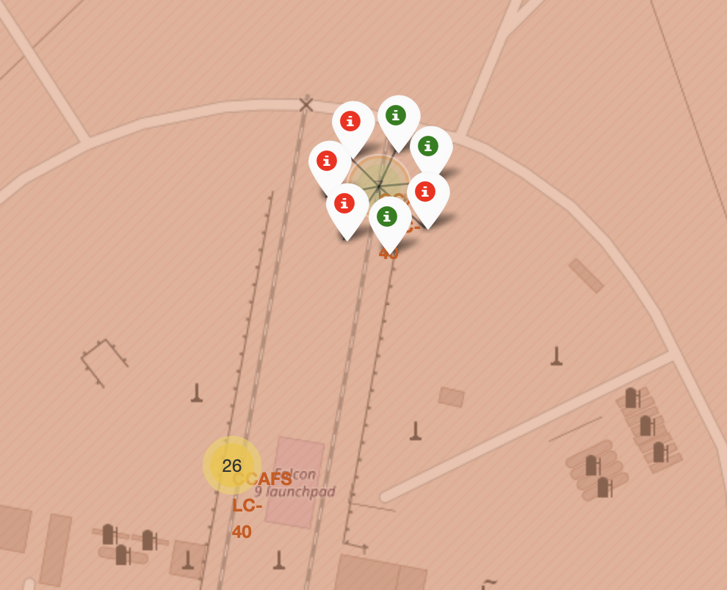
<Folium Map Screenshot 2>
Mark the success/failed launches for each site on the map
Success -> green marker
Failed -> red marker
Launch sites with relatively high success rates can be easily identified

Slide 37
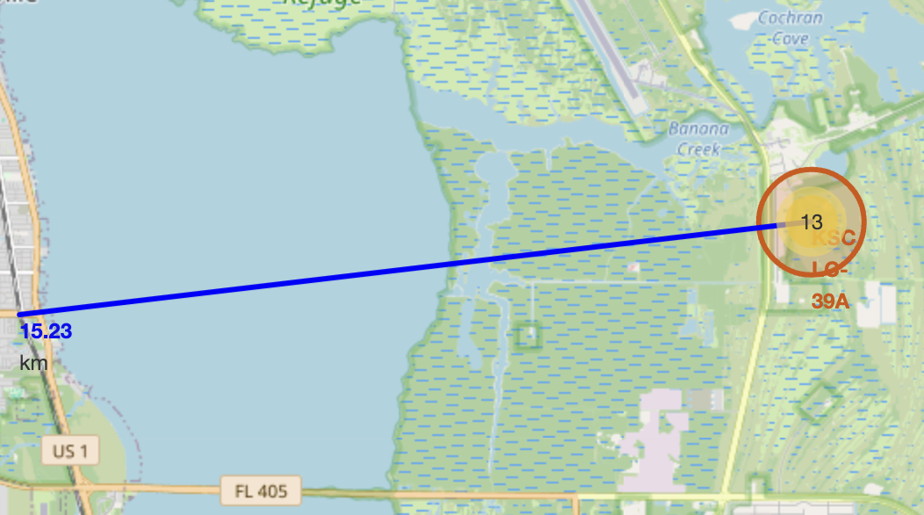
<Folium Map Screenshot 3>
Calculate distances between launch site to its proximities
For example: launch site KSC LC-39A is 15.23km away from the railway.
Have a gauge on the impact of failed rocket launches to its proximities.

Slide 38

Section 4

Slide 39
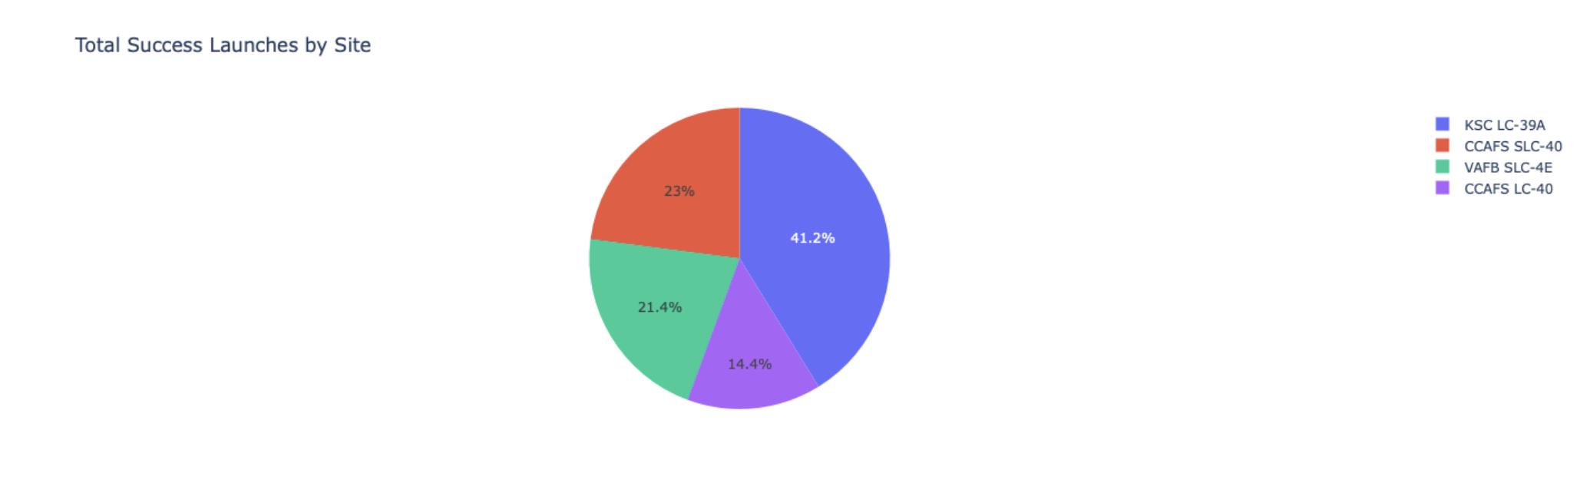
<Dashboard Screenshot 1>
Launch success count for all sites
Explanations:
The chart shows that KSC LC-29A has a higher proportion of successful launches compared to the rest.

Slide 40
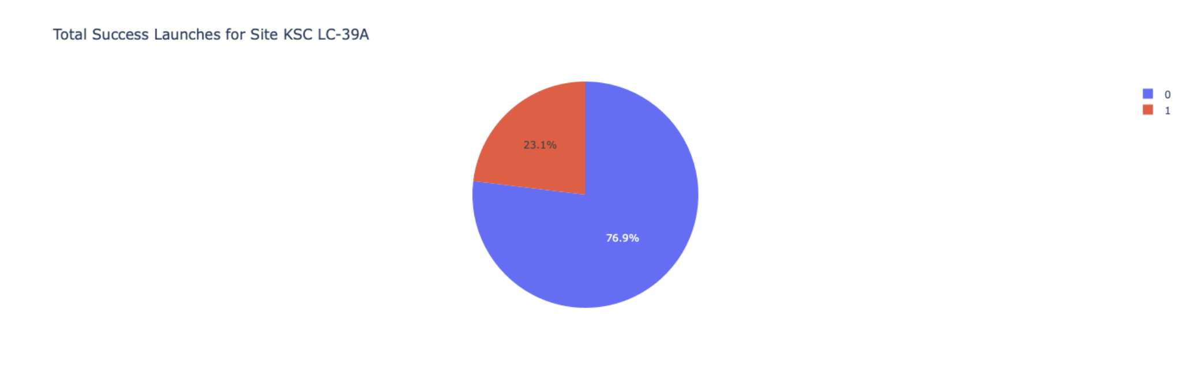
<Dashboard Screenshot 2>
Launch site with the highest launch success ratio
Explanations:
The pie chart shoes that the launch site KSC LC-29A has a high success rate of (76.9%) with 10 successful launches and only 3 failed launches.

Slide 41
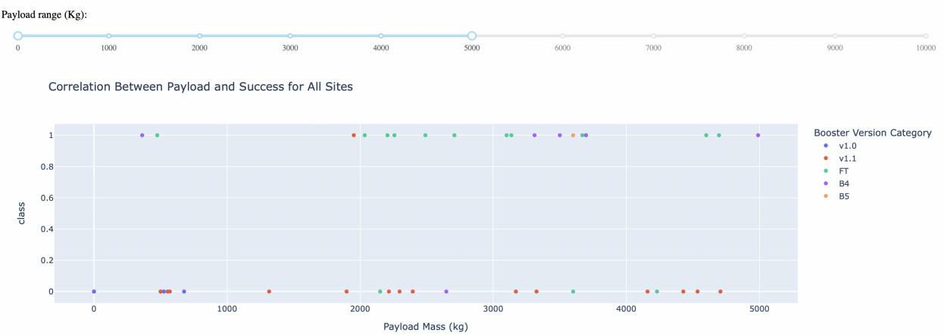
<Dashboard Screenshot 3>
Payload Mass vs. Launch Outcomes for all sites
Explanations:
The chart shows that payloads between 2000 and 5500 kg have the highest success rate

Slide 42

Section 5

Slide 43
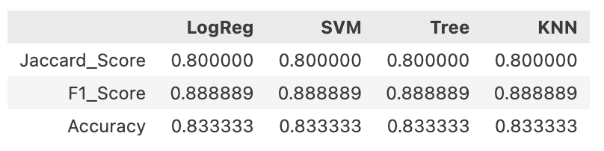
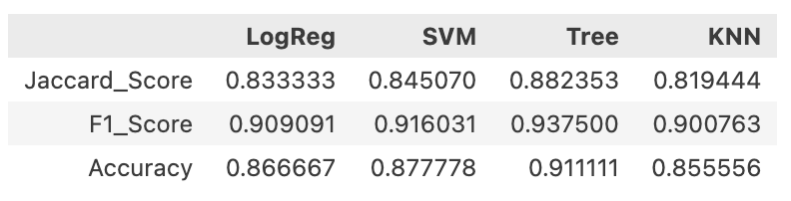
Classification Accuracy
Model is evaluated using Jaccard Score, F1 Score and Accuracy of the Test set.
All the models have the same Test Set scores.
Due to limited sample size, the models are tested on whole Dataset, in order to find the best performing model.
Upon evaluation, Decision Tree model has the highest score and accuracy making it the best model.
Evaluation on Test Set
Evaluation on Whole Dataset

Slide 44
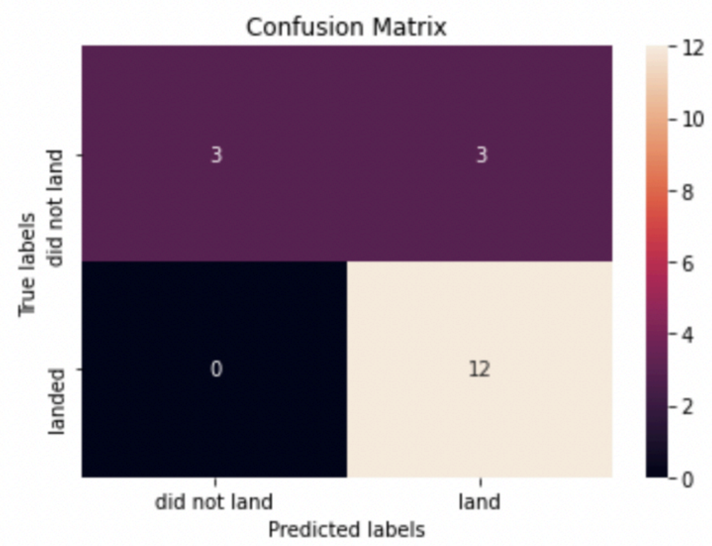
Confusion Matrix
Evaluating the confusion matrix, the decision tree model can distinguish between the different classes.
The model correctly predicted 12 instances where the rocket's first stage did land.
Accuracy: (TP + TN) / (TP + TN + FP + FN)
Precision: TP / (TP + FP)
Recall: TP / (TP + FN)

Slide 45
Conclusions
Out of all the models, Decision Tree model is the best suited algorithm for the spaceX dataset.
Most of the sites are in close proximity to the coast.
The success rates of the launches increases over the years.
KSC LC-39A has the highest success rate of launches compared to other launch sites.
Orbits ES-L1, GEO, HEO and SSO have 100% success rate.

Slide 46


